Slide 2
Social-Emotional Learning and Holiday Dances: A Festive Combination
Christine Fisher
2020 National and Southern District Dance Education Teacher of the Year
Eastern Guilford Middle School, Gibsonville, NC
Cynthia (Cindi) Parise Bosco
2020 Eastern District Dance Education Teacher of the Year
Enlarged City School District, Middletown, NY

Slide 3
What Are You Looking Forward to Most Over Break

Slide 4
We Can All Agree on SNOW!
-Band of Merry Makers, “Snow, Snow, Snow”
-Fun follow along, nontechnical
-Dance as celebration
-Dance as community building
-Dance as performance
- Dean Martin, "Let it Snow, Let it Snow, Let it Snow”
- Vince Guaraldi, “Skating” You might recognize from The Peanuts

Slide 5
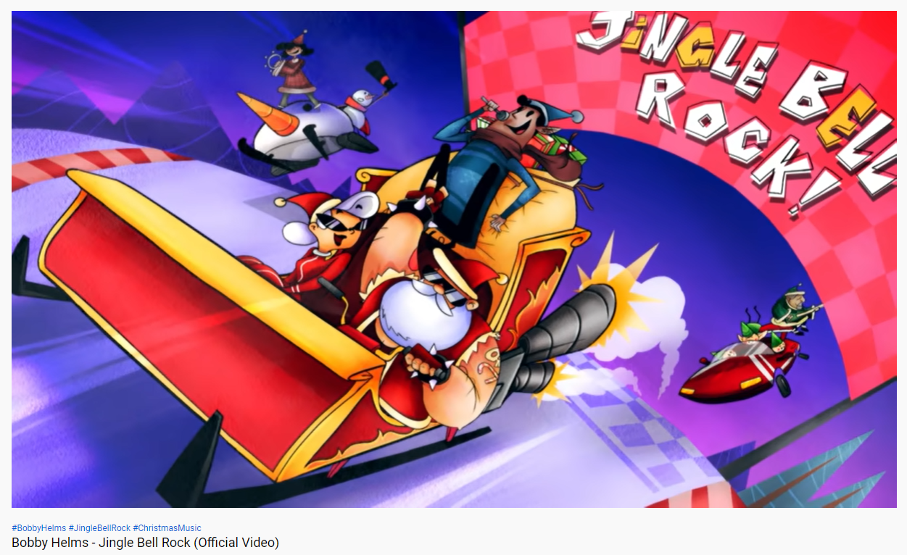
JINGLE BELL ROCK
https://youtu.be/ZnDmmiiFSUU
Song by Bobby Helms

Slide 6
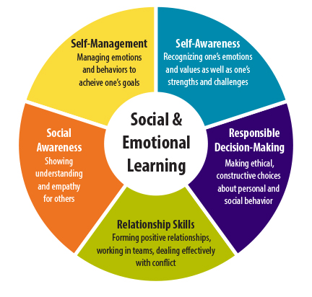
Social Emotional Learning
-Self Management,
-Self Awareness,
-Social Awareness,
-Responsible Decision-Making
-Relationship Skills

Slide 7
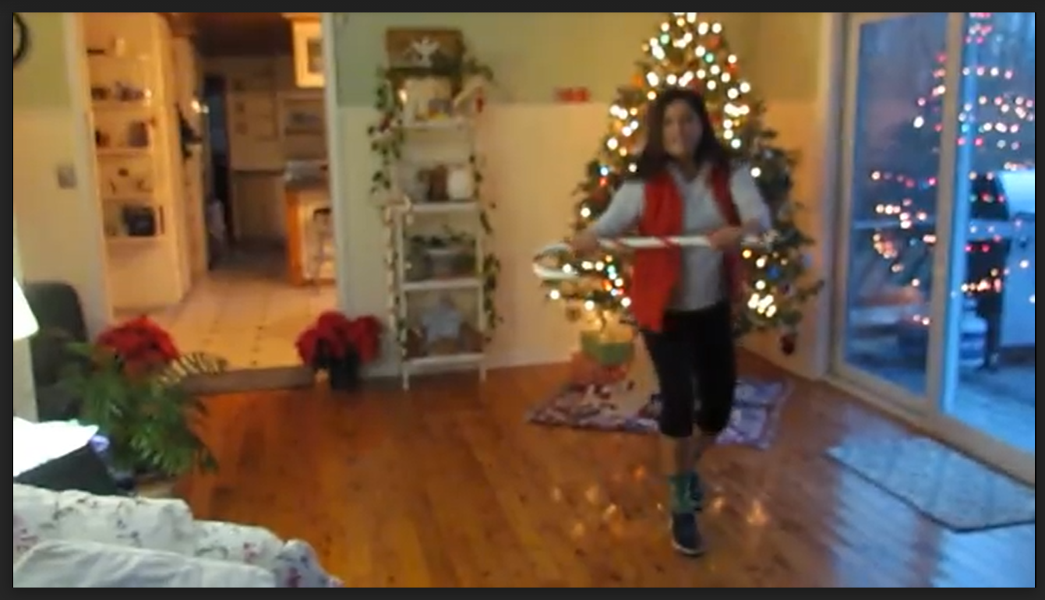
Learn the Dance
https://drive.google.com/file/d/1zS8PqTE0QfyD-uyQzHlG_w8CjKLXIEmN/view?ts=5fdba0af

Slide 8
Dance Notation - Steps 1 -3*
Step Right Left Right, Left Right Left, Right Left Right,
(prepare/1st position plie) down (jump) up (land) down
2. (3 step turn) step Right, step Left, step Right, KICK Left (reverse)
(3 step tun) step Left, step Right, step Left, KICK Right
3. (Softshoe style) Step Right, Left (foot goes in front), Right (reverse)
Step Left, Right (foot goes in front), Left, Step Right , L front, L back, L front,
Turn step Left brush Right st st brush st st brush st st, grapevine Right, (back) L (jump) R (front) L (side)R!!!

Slide 9
Dance Notation Continued - Steps 4-6
*REPEAT STEPS 1-3:)
4. Step touch 4x (or freestyle:) ROCK RLRL triple hips RLR LRL
5. Step touch 4x (or freestyle:) JUMP into your toboggan
6. Cramp roll 4x (be like a horse!!) Step RLR LRL RLR LRL
Turn to the Right step Right brush Left st st brush st st brush st st

Slide 10
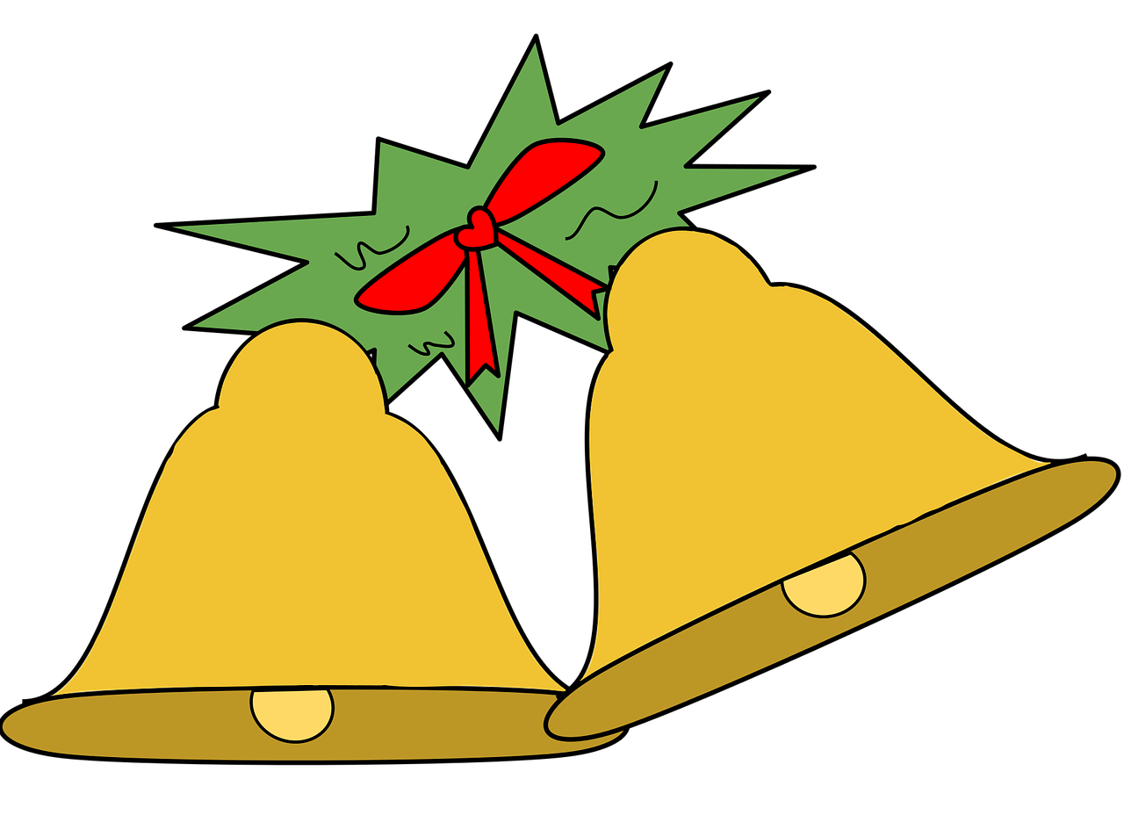
Dance Notation Continued-Steps 7,8 and a BIG Ending with a Cane Trick
7. Sway Left, Sway Right, Turn Left Right Left (3 step turn)
8. Step Right Touch Left (& 1 tap cane on floor) FLIP the cane and catch! Twirl and put under your right arm, Left hand to Hat (or make believe top hat) step kick exit or do it all again! Have Fun!!

