Slide 2


Best Practice Tips for Teaching Dance Education On-Site with Physical Distancing & Within a Virtual Setting
Christine Kiernan Fisher
2020 National and Southern District Dance Education Teacher of the Year
Eastern Guilford Middle School in Gibsonville, NC
Ashley Gross
2020 Central District Dance Education Teacher of the Year
Woodman Elementary in Wichita, KS

Slide 3
1. Keep up your routines.
2. Say YES! Keep your students powered on!
3. Keep your expectations clear and continue to hold the students accountable.
4. Keep it FUN for those who are not able to be in live classes!
Connect Outside of Class

Slide 4
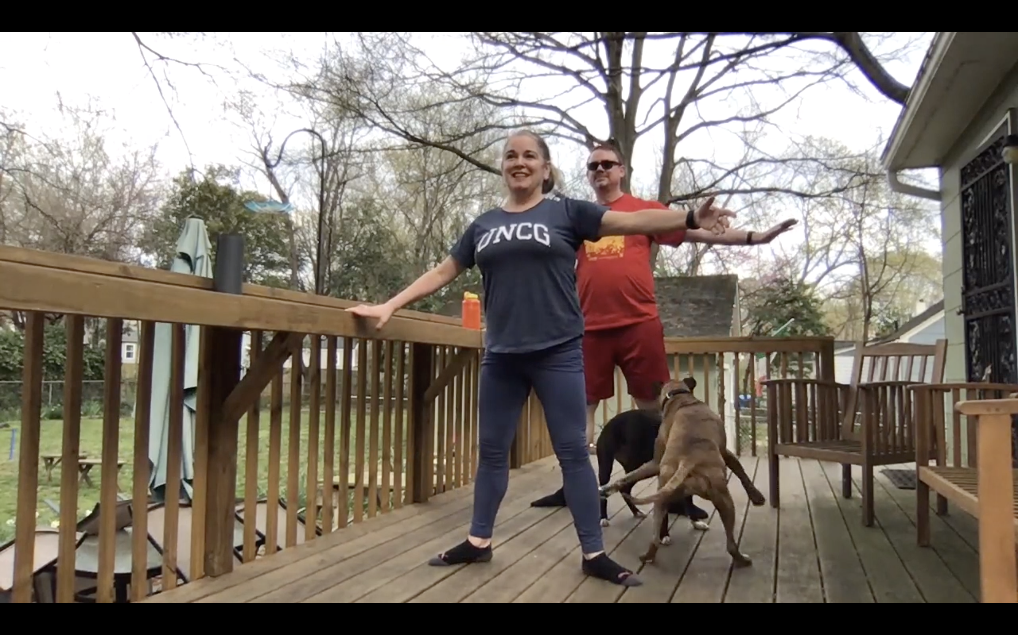
Keep it FUN!
Back Deck Ballet

Slide 5



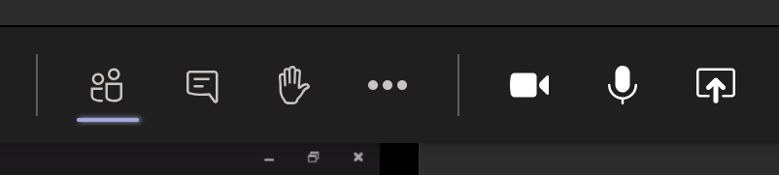
Are you on Mute?

Slide 6
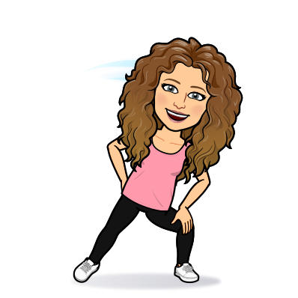



Be an Active Listener
Eyes Ears Voice Body
Eyes on your screen when the teacher is talking or giving directions.
Make sure you are in a quiet place were you can hear the teacher. Turn it up!!
Please mute yourself, and the teacher will call on students to share.
Stand with your device in front of you. Be in an open space.

Slide 7

What Does Remote Dance
Look Like?
Log-in to join!
Warmup & Stretch
Skill lesson & Skill Practice
Combo
Cool Down

Slide 8
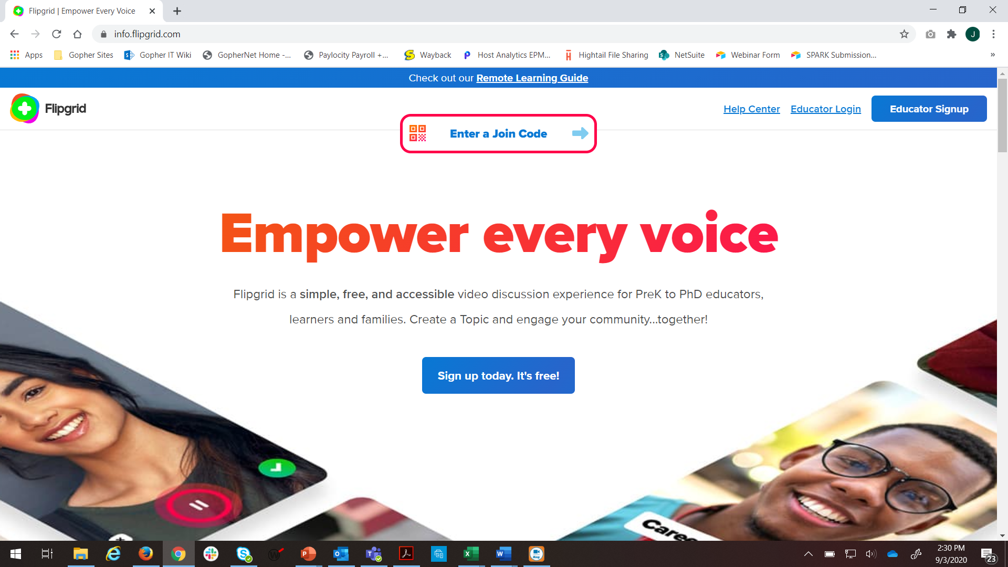
Flipgrid

