Slide 2
Teaching Sensitive Subjects
Melanie Lynch
2016 SHAPE America Health Education Teacher of the Year
Health and PE teacher at North Allegheny Intermediate High School Pittsburgh, Pennsylvania

Slide 4
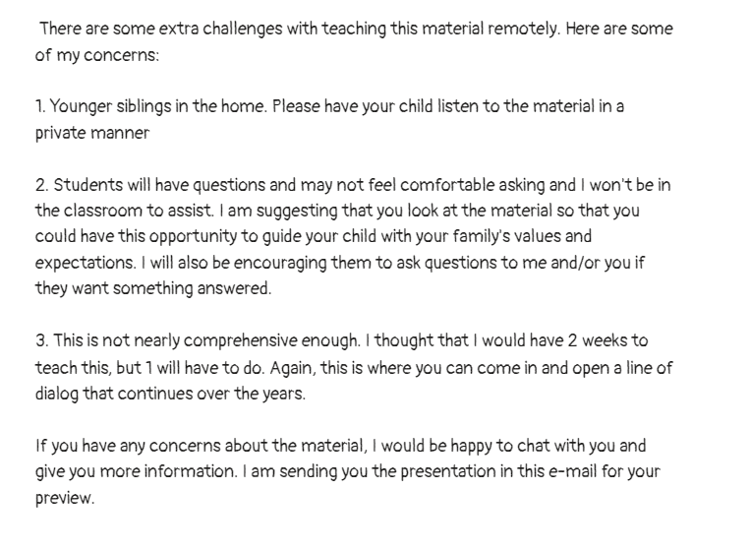

Slide 5
http://www.tinyurl.com/berealbeready

Slide 6
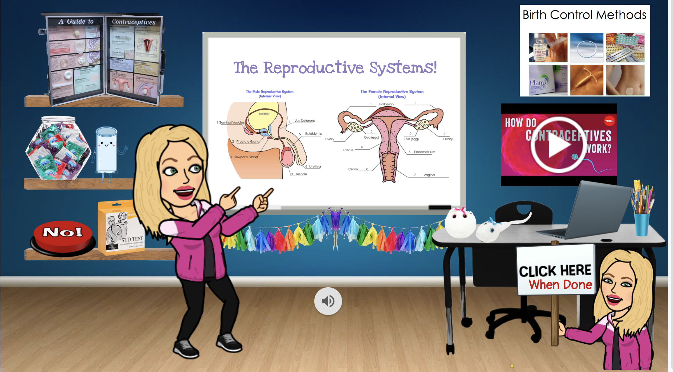

Slide 9
@MelanieLynch52

